Slide 1
North Point Government Primary School 60 ^{th} Anniversary Open Day
Date: 24th May, 2014
Venue: NPGPS

Slide 2
Opening Ceremony
Invitation cards

Slide 3
NPGPS was opened on…

Slide 4
Blessings from friendly schools and guests.

Slide 5
Opening Ceremony

Slide 7
The hosts

Slide 8
The inauguration speech by our Principal, Miss Tang.

Slide 9
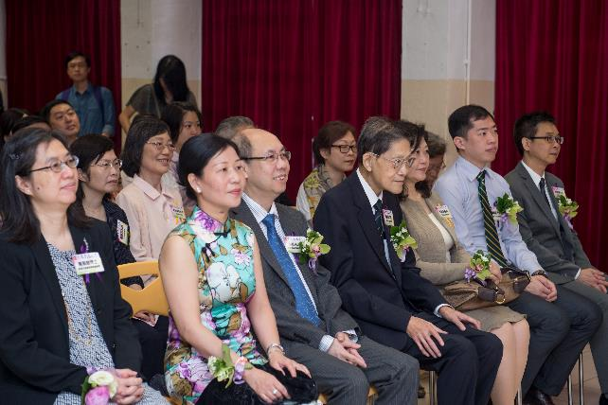
Our honourable guests…

Slide 10
The student hosts

Slide 11
The alumni band started the show.

Slide 12
Our school choir

Slide 13
Our school orchestra

Slide 14
The choir performed with the school orchestra.

Slide 15
Dancing performance by the school dancing team.

Slide 16
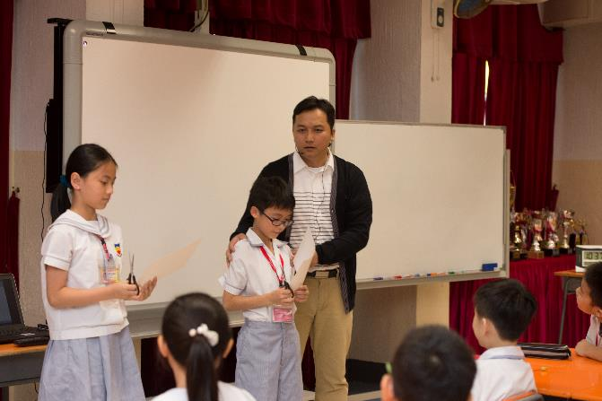
A teaching demonstration by Mr. Lam.

Slide 17
Displays of pupils’ artwork.

Slide 18
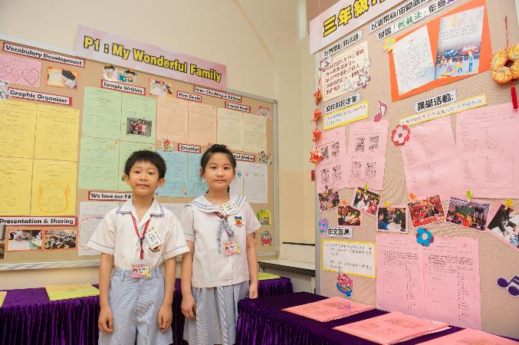
Displays of pupils’ writing works.

Slide 19
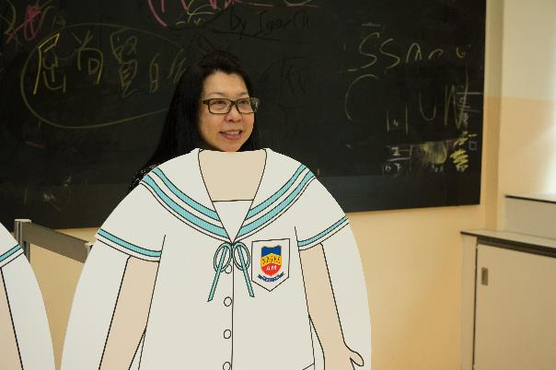
Photo-taking area of the school uniform changes.

Slide 20
Charity sale for the NPGPS Alumni

Slide 21
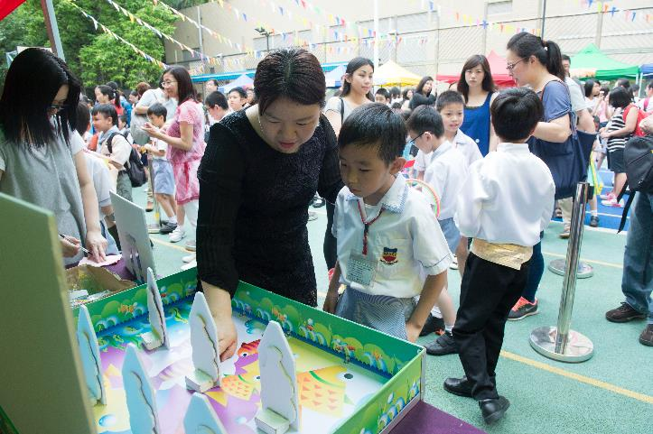
The game booths at the playground.

Slide 22
Display of pupils’ achievements.

Slide 23
Thank you!

